Slide 1
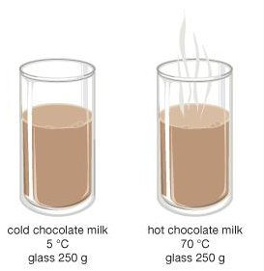
Skill Development/Guided Practice
Comparing Thermal Energy
Identify whether the temperature or the volume of the objects is the same. Same temperature = larger object has more thermal energy Same volume = hotter object has more thermal energy Explain why the object has more thermal energy
The objects are the same ________. The __________ has more thermal energy because _________________.

Slide 2
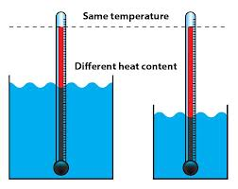
Skill Development/Guided Practice
Comparing Thermal Energy
Identify whether the temperature or the volume of the objects is the same. Same temperature = larger object has more thermal energy Same volume = hotter object has more thermal energy Explain why the object has more thermal energy
The objects are the same ________. The __________ has more thermal energy because _________________.

Slide 3
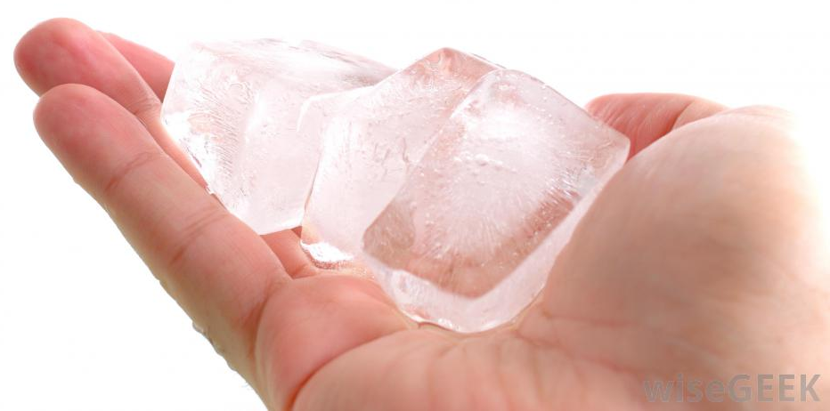
Concept Development
CFU 1
Describe what happens when you touch a hot object.
Thermal Energy Transfer: Conduction
When two objects are in direct contact, thermal energy is transferred through conduction.
Consider what happens when an ice cube sits in your hand:
The particles in your hand are at a higher temperature, so they have more kinetic energy and vibrate faster.
The quickly vibrating particles in your hand bump into the slower moving particles in the ice cube.
When the particles collide, energy transfers from your hand to the ice cube, causing it to warm up.

Slide 4
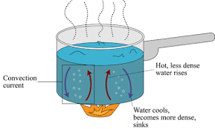
Concept Development
CFU 1
Think, Pair, Share: Describe another situation where thermal energy is transferred by convection.
Thermal Energy Transfer: Convection
Thermal energy moves by convection in liquids and gases.
Convection currents carry thermal energy through liquids and gases as the particles move.
Consider what happens when water is heated in a saucepan:
Thermal energy is transferred from the saucepan to the water through conduction.
The water particles in contact with the metal heat up and become less dense.
The heated particles begin to rise, and cooler ones take their place.
The heated water particles take thermal energy with them as they move.

Slide 5
Thermal Conductors and Insulators

Slide 6
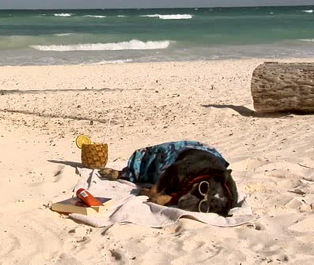
Learning Objectives
CFU
What are we going to learn?
Identify and describe thermal conductors and insulators.
Plan an experiment to investigate the effectiveness of different insulators.
Activate Prior Knowledge
Think, Pair, Share: Name two materials that thermal energy can travel through easily by conduction. Name two materials that thermal energy cannot travel through easily by conduction.

Slide 7
Concept Development
CFU 1
Which way is heat transferred?
Thermal Energy Transfer Through Conduction
Thermal energy is transferred from hot to cold objects.
When two objects are in direct contact, thermal energy is transferred through conduction.
CFU 2
When does energy transfer by conduction occur?

Slide 8
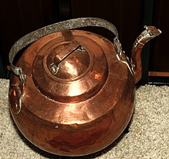
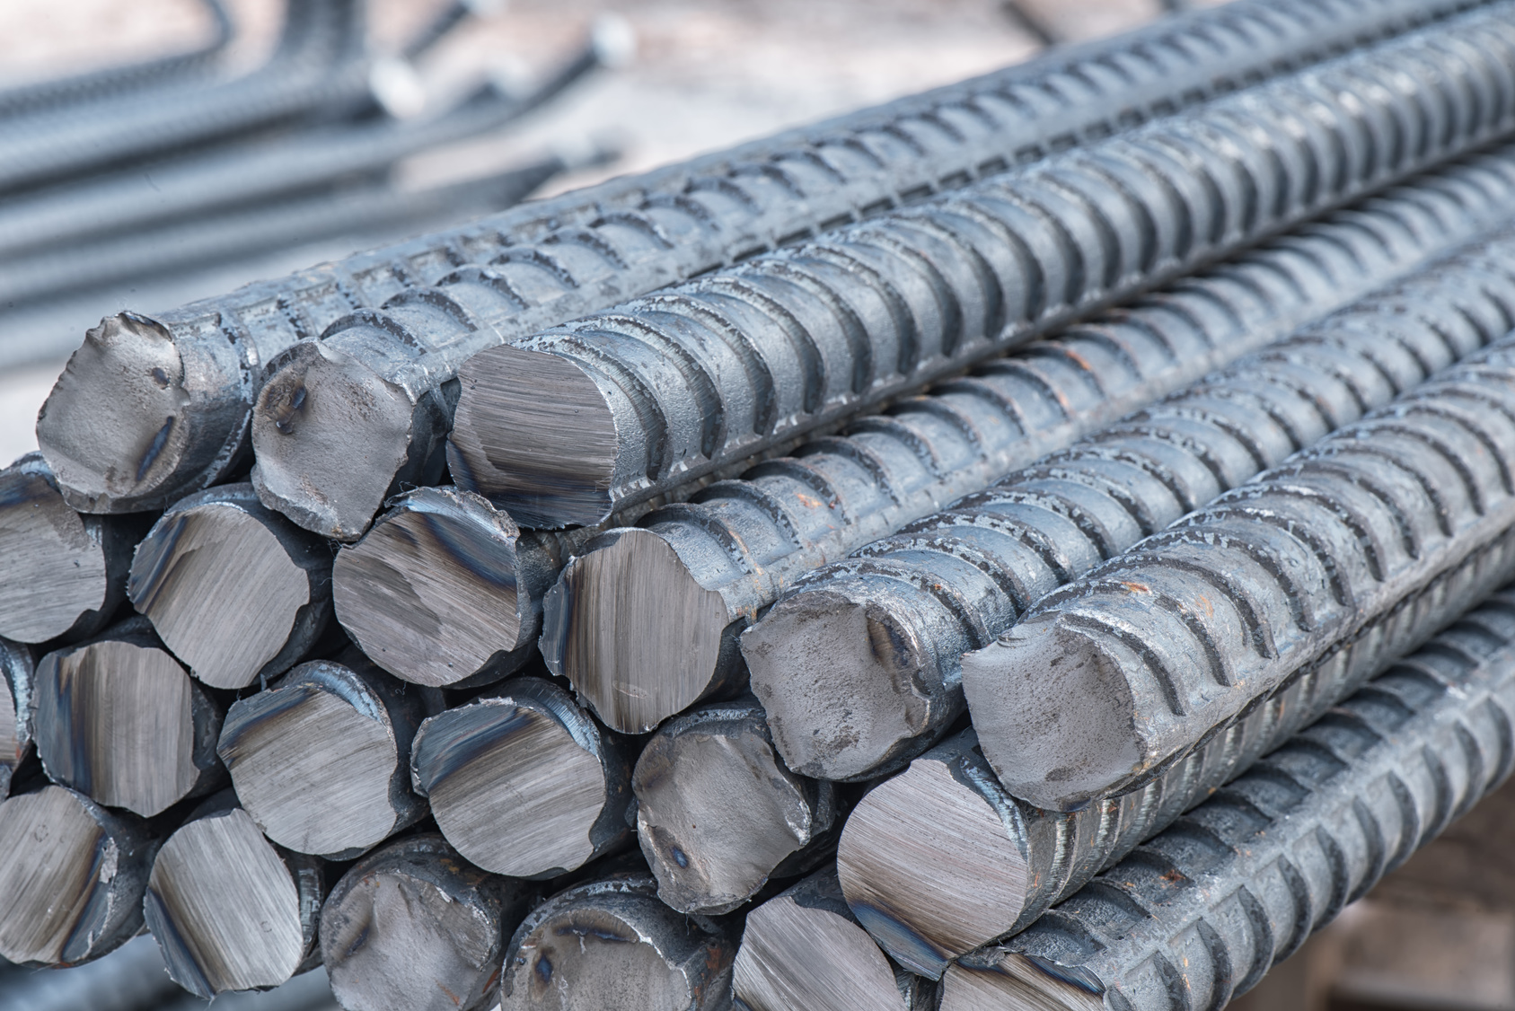
Concept Development
CFU 1
What is a thermal conductor?
Conductors
A thermal conductor is any material that allows thermal energy to flow easily through it.
Metals, for example copper and iron, are good conductors of thermal energy.
Some conductors are better than others, transferring energy more easily.
CFU 2
What type of materials make good conductors? Name two examples of good conductors.

Slide 9
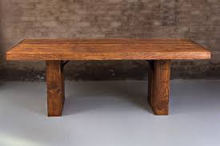
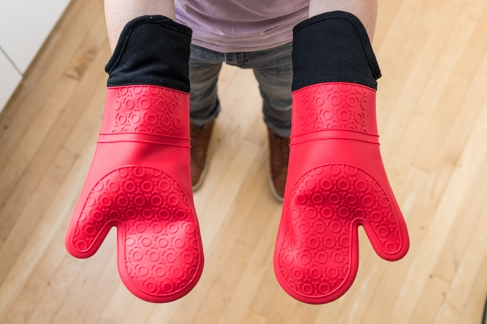
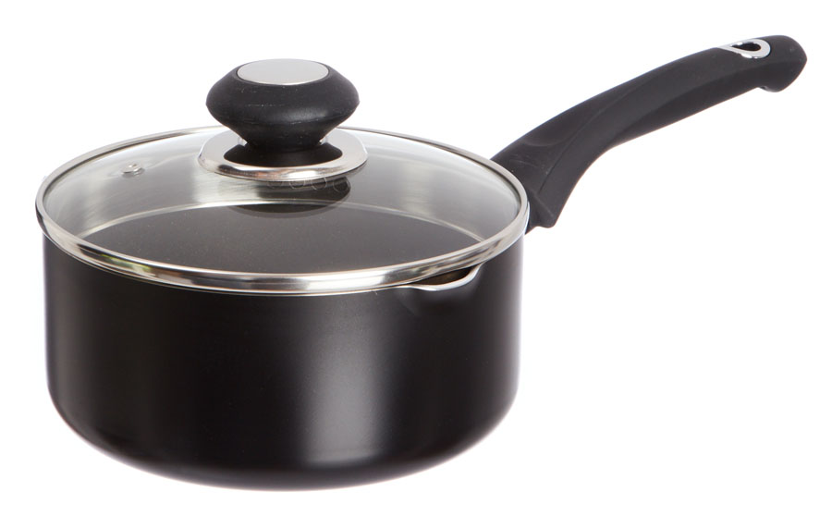
Concept Development
CFU 1
What is a thermal insulator?
Insulators
A thermal insulator is any material that prevents thermal energy from passing through it.
Most non-metallic materials, for example air, plastic, wood and rubber, are good insulators of thermal energy.
Some insulators are better at preventing energy transfer than others.
CFU 2
What type of materials make good insulators? Name two examples of good insulators.
CFU 3
Why are the base and sides of saucepans often made from metal, while the handle is made from plastic?

Slide 10
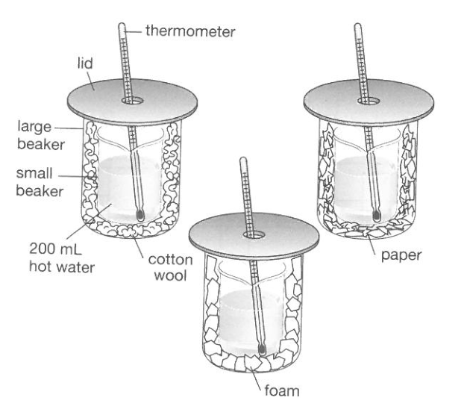
Skill Development/Guided Practice
You are now going to plan an investigation to test the effectiveness of different insulating materials.
You are going to conduct an experiment similar to the one shown below.
You will fill a small beaker with hot water and place it inside a larger beaker. The space between the two beakers will be filled with an insulating material of your choice.
You will need to measure the temperature of the water in the small beaker over a period of time.

Slide 11
Skill Development/Guided Practice
You are now going to plan an investigation to test the effectiveness of different insulating materials.
You will have access to the following materials to use as insulators:
Cotton wool, fabric, sawdust, packing peanuts and newspaper.
Your group will need to test three materials, as well as air to represent no insulating material. You will have one class period to conduct your investigation.

Slide 12
Skill Development/Guided Practice
You are now going to plan an investigation to test the effectiveness of different insulating materials.
You will be required to write up and hand in a report on your investigation, which will go towards your second semester report.
You may plan your investigation on your device or on paper.

Slide 13
Skill Development/Guided Practice
Insulating Materials Available
Cotton wool Fabric Sawdust Packing Peanuts Newspaper
Writing your aim
A statement of what are you trying to find out in this investigation.
Write your aim in the form: “To find out if/whether/which . . . .”
Before you continue, your group needs to choose your insulators

Slide 14
Skill Development/Guided Practice
Insulating Materials Available
Cotton wool Fabric Sawdust Packing Peanuts Newspaper
Writing your hypothesis
A testable statement of what you believe will be the outcome of the experiment.
Write your hypothesis as a statement, for example: “Air is the most effective thermal insulator”
Do not use the words “I predict” or “I think”.
Do not write it in the form of “this will happen” as this becomes a prediction, not a hypothesis.

Slide 15
Skill Development/Guided Practice
Insulating Materials Available
Cotton wool Fabric Sawdust Packing Peanuts Newspaper
Identifying the Variables
You need to think about how to make your investigation a fair test.
Identify the variables in your investigation:
Independent variable (what you are changing)
Dependent variable (what you are measuring/observing)
Controlled variables (what you need to keep the same) – at least 3

Slide 16
Independent Practice
Insulating Materials Available
Cotton wool Fabric Sawdust Packing Peanuts Newspaper
List of Equipment and Diagram
Make a list of all the equipment you will need to use in your investigation (include the materials you will be testing) and draw a labelled diagram of how you will set up your equipment.
Method
Write a method by which you can change one variable and measure its affect on the other.
Be specific with the steps in your method. You may need to revise it before you write the report.
Results
Construct a table so that you can record the changes in the variables.

